Slide 1
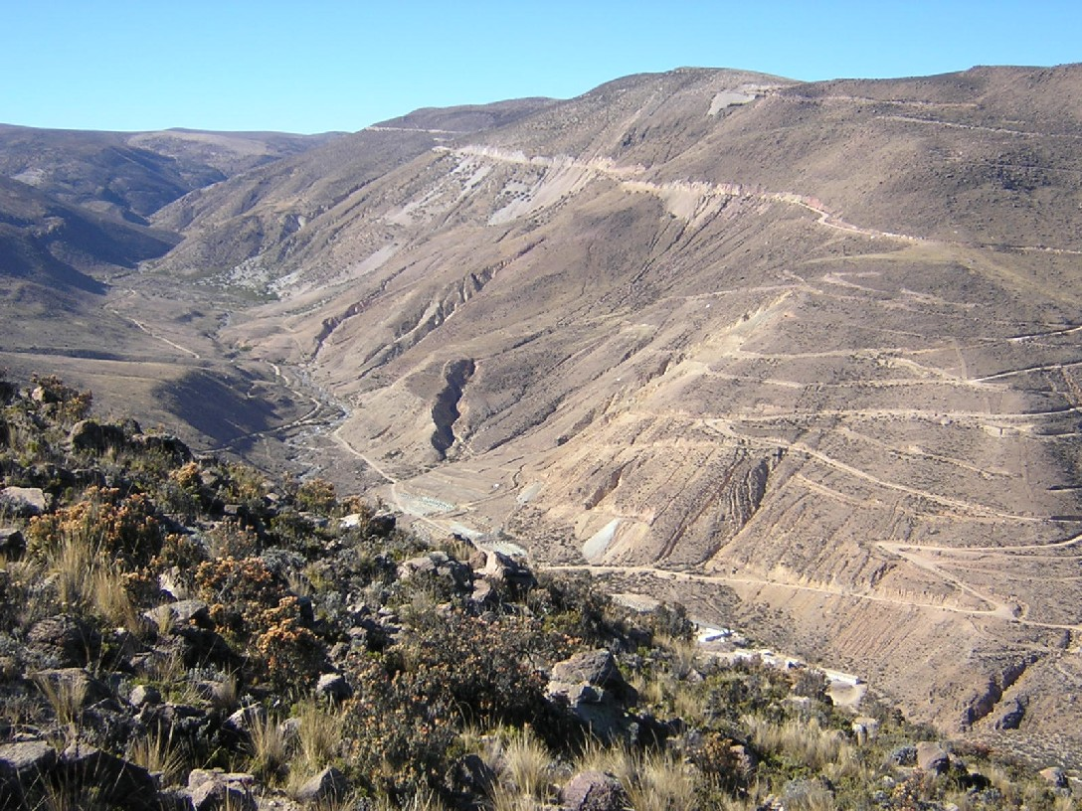
Society of Economic Geologists Foundation
Student-Dedicated Field Course
QUELLAVECO GEOLOGY
Rubén Mattos
Set 2012

Slide 2
CONTENTS
  Location
  Regional Geology
  Local Geology
  Supergene Alteration and Mineralization.
  Hydrogeology

Slide 3
1.0
LOCATION

Slide 4
Country: Perú
Region: Moquegua
Province: Mariscal Nieto
District: Torata
Elevation: 3500 - 3800 msnm.
n
Quellaveco
Lat: 17°06’S
Long: 70°37’O
Notes:
4

Slide 5
2.0
REGIONAL GEOLOGY

Slide 6
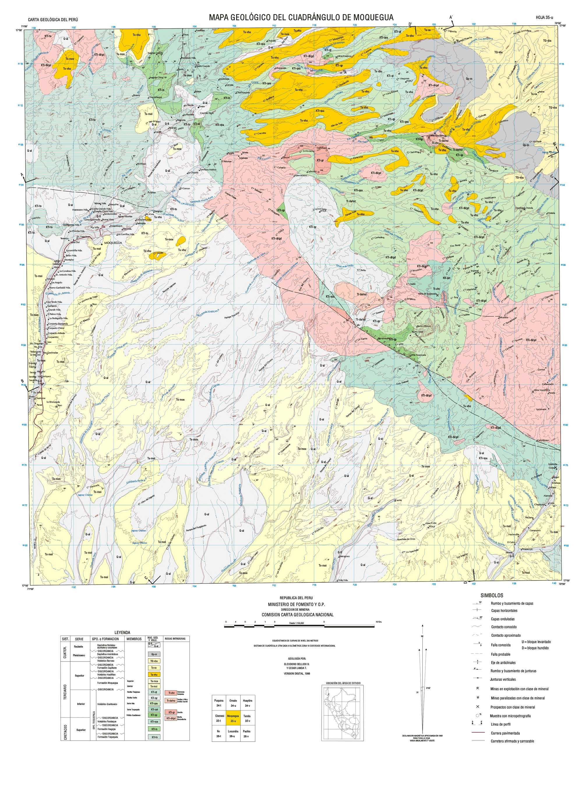
ROCAS INTRUSIVAS
Ti-ctrv
Chimenea
Volcánica
Ti-da/mz
Dacitas y Monz cuarc.
Falla Botiflaca
Granito
MINA CUAJONE
KTi-gr
Kti-dt/gd
Diorita a
Granodiorita
Falla Asana
GRUPO ó FORMACION
MIEMBROS
ROC. SED
Y VOLCANICAS
Falla Quellaveco-Cuajone
Depósitos fluviales,
Aluviales y coluviales
Q-ti
Q-al
PROY. QUELLAVECO
Falla Samanape
Depósitos morrénicos
Qp-m
Falla Micalaco
Volcánico Barroso
TQ-vba
MOQUEGUA
Fm. Capillune
Ts-ca
Volcánico Huaylillas
Ts-vhu
MINA TOQUEPALA
Fm. Moquegua
Superior
Ts-mos
Falla Incapuquio
Inferior
Ts-moi
RiolítaTinajones
Kti-qt
Riolíta Yarito
Kti-qy
Volc. Quellaveco
Serie Alta
Kti-qsa
Serie Toquepala
Kti-qst
Porfído Quellav.
Kti-qp
Volc. Paralaque
Kti-vpa
Fm. Inogoya
Kti-in
Fm. Toquepala
Kti-to

Slide 7
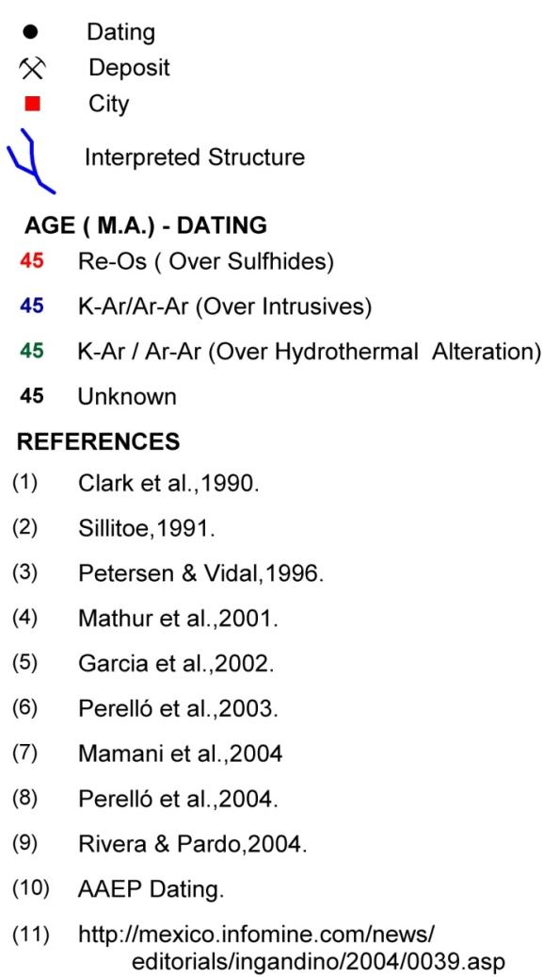
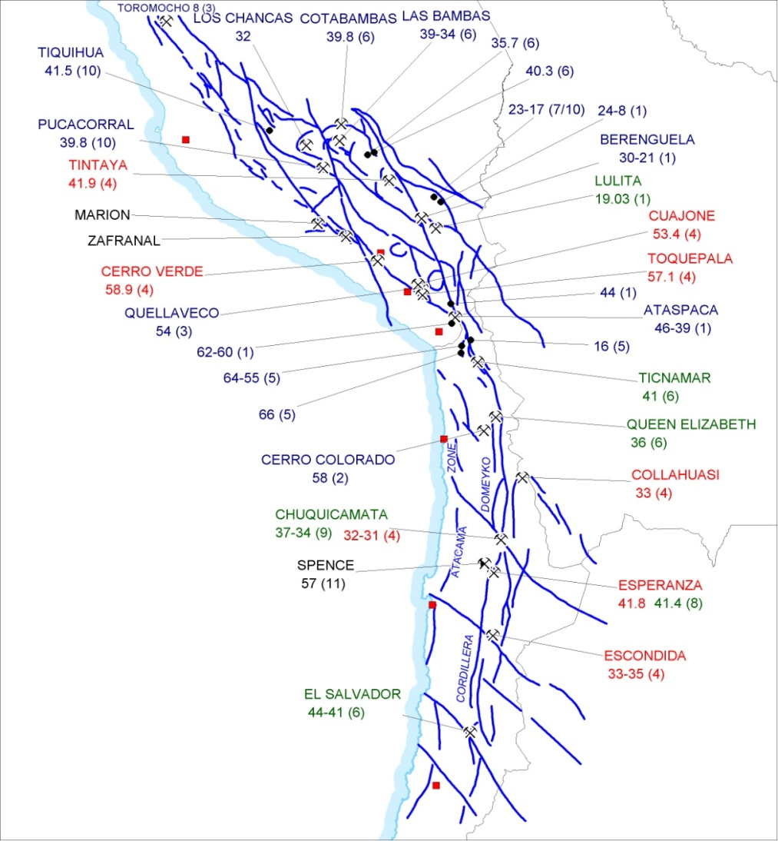
METALOGENIC BELTS NORTHERN CHILE AND SOUTHERN PERU
Abancay Deflection
Tía María
Arica Elbow
Notes:
18/09/2012
7

Slide 8
3.0
LOCAL GEOLOGY

Slide 9
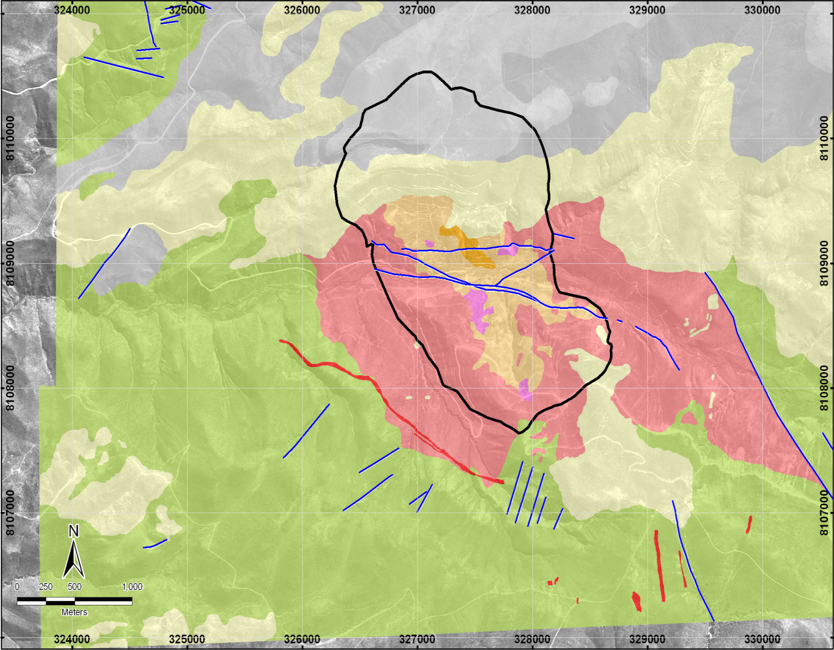
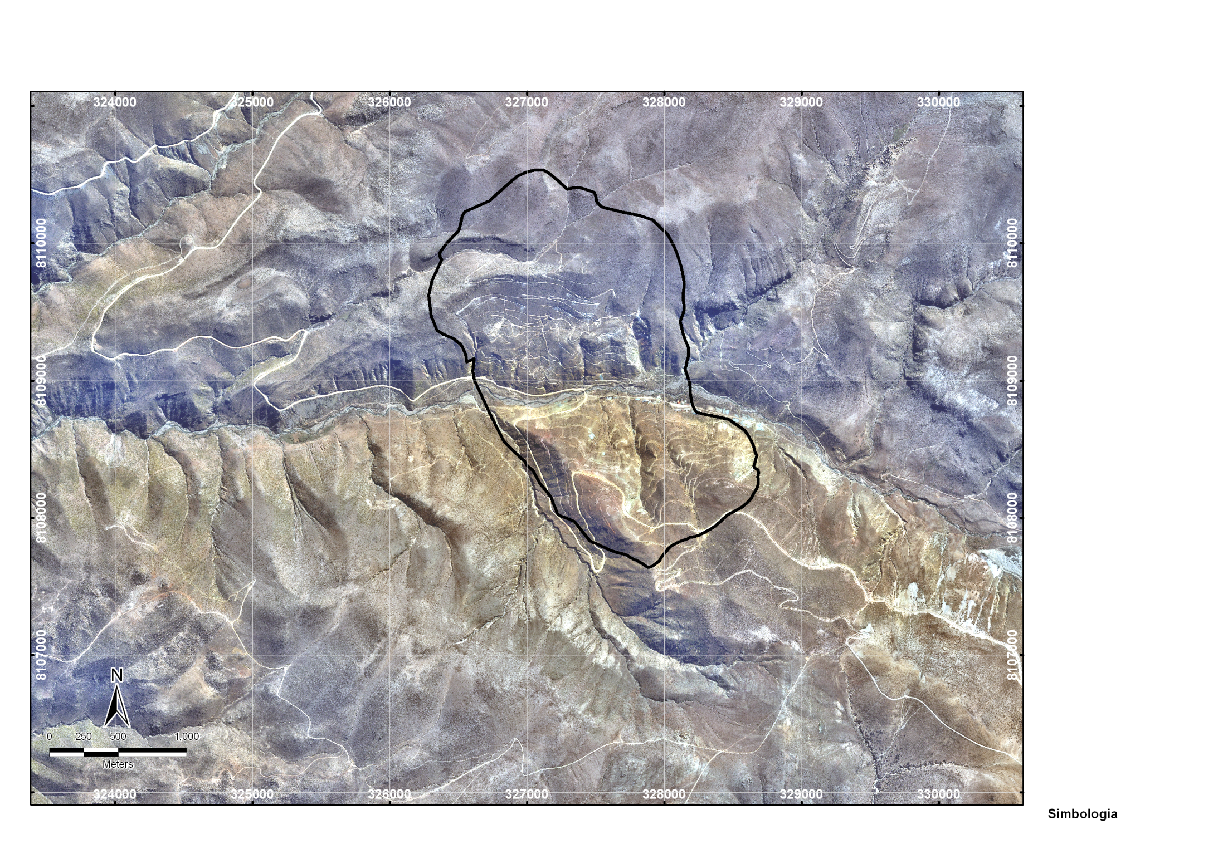
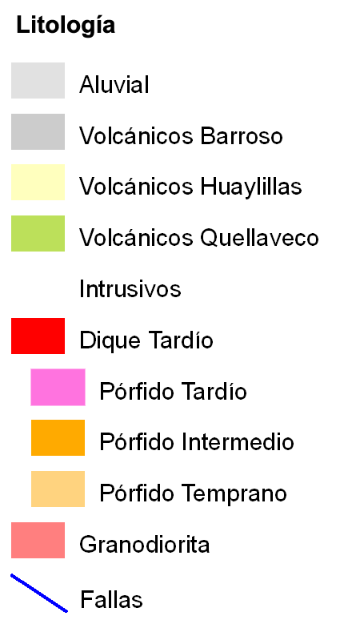
Final Pit
Falla Asana
Falla Quellaveco
54.7 ma
a
55.2 ma
58.3 ma
Notes:
18/09/2012
9

Slide 10
4.0
SUPERGENE ALTERATION AND MINERALIZATION

Slide 11
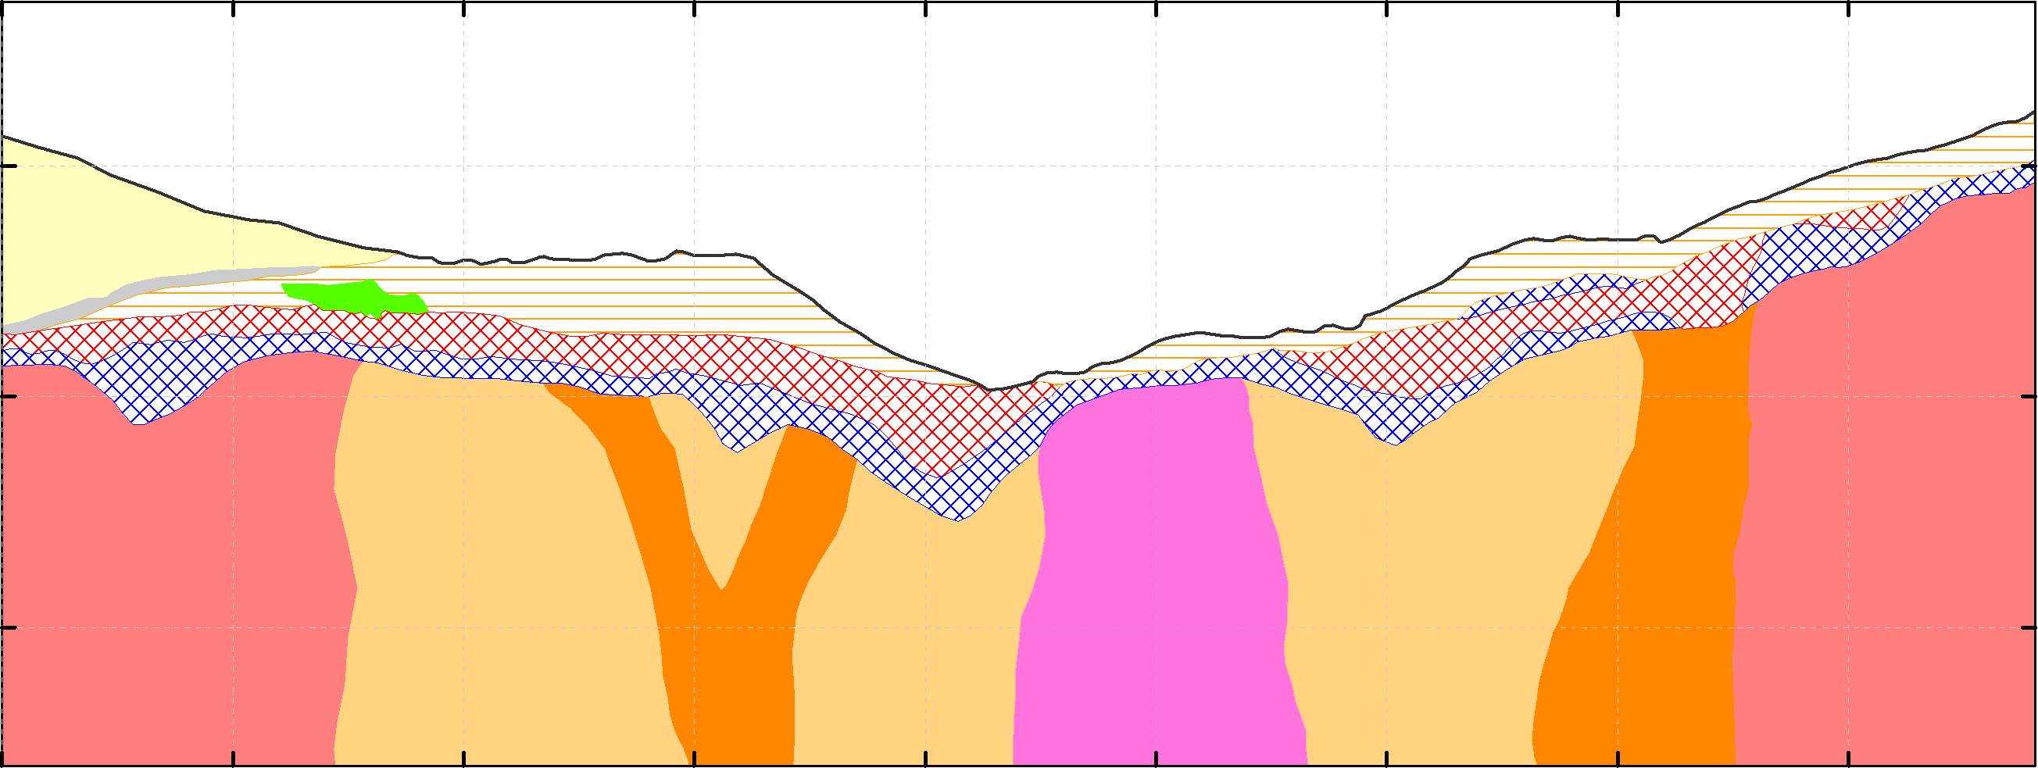
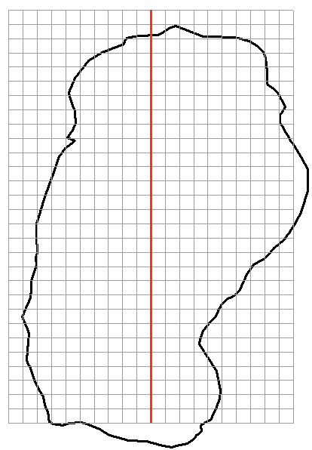
Ignimbrite
Conglomerate
Strong secondary enrichment
Weak secondary enrichment
Leach zone
Oxide/Sulfide
21500
21250
21000
20750
20500
20250
20000
19750
3750
SECTION 11000
Primary zone
3750
Asana River
3500
3500
3250
Regional Granodiorite
Early Porphyry
Late Porphyry
Intermineral Porphyry

Slide 12
Leach Zone
Occurs from the surface and parallel to it, between 0 and 130m. It result from action of rainwater.
The leach caused kaolinization of plagioclase and feldespars and also promoted formation of montmorillonite from biotite-chlorite.
Two types of leached cap may be observed, hematitic and jarosite cap.
Hematitic was formed in granodiorite and early porphyry, abundant sericita-Kaolinite, traces of brochantite, plus alunite filling fractures.
Jarositic result of primary sulfides, presence of kaolinite and jarosite both in fractures and in disseminated form, with goethite, turquoise and chrysocolla.

Slide 13
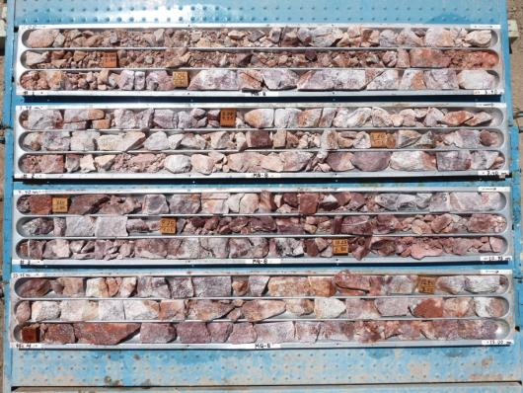
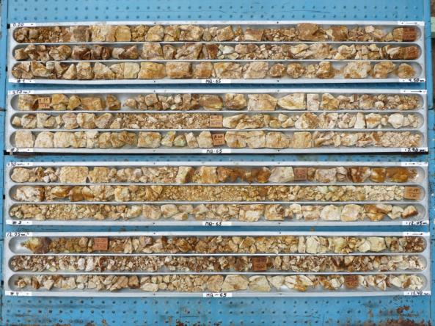
MQ8
Hematitic: from enrich sulfides chalcosite 0.03% Cu, 7.9% Py.
EZ: 1.5% CuT
PZ: 0.6% CuT
MQ65
Jarosite: from primary sulfides pyrite, 0.13% Cu, 4.22% Py.
EZ: 1.1 CuT%
PZ: 0.5 CuT%

Slide 14
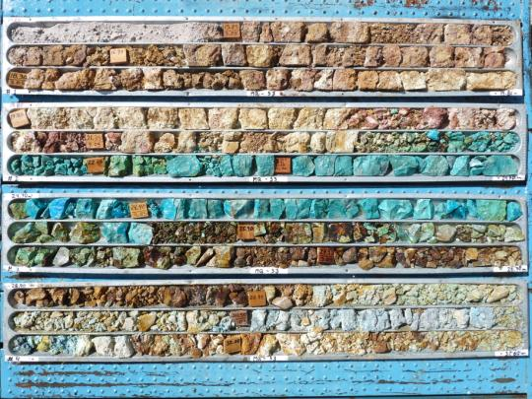
Copper Oxide Zone
Occurs in small and irregular bodies in the north side (carbonate and silicate).
Where initial pyrite content is less than in the south part, which is confirmed by occurrence of supergene alunite. In the south side don’t have oxide bodies due early erosion.
MQ53
The oxide minerals are malachite, crysocolla, chalcantite, atacamite, cuprite, neotocite occur in veinlets and disseminated.
Accompanied limonite and secondary copper sulfides.
85% CuAcS.

Slide 15
Secondary Enrichment Zone
Is located between the leached zone and the primary sulfide zone, has an average thickness of 60 m and forms a blanket parallel to the surface, representing de water table.
This phase occurred rapidly, due to quick uplift of the area.
The erosion caused by the Asana River after the Middle Miocene removed part of the ignimbrite cover, leached cap and enriched zone.
It is characterized by the presence of chalcosite, covellite and digenite, are replacing pyrite and chalcopyrite.

Slide 16
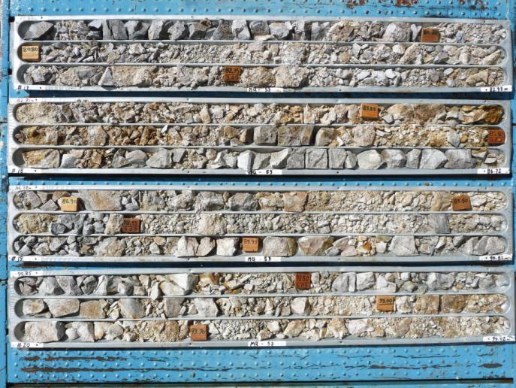
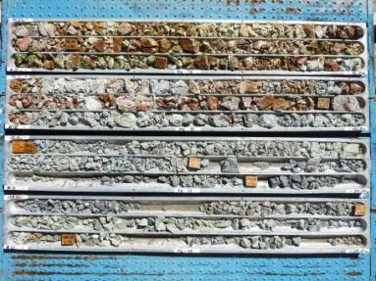
MQ53
Enrichment zone,
2.1% CuT, 4.29% Py.
LZ: 0.24 CuT%
PZ: 0.64 CuT%
MQ95
Enrichment zone.
1.7% Cu, 2.38% Py.
LZ: 0.07 CuT%
PZ: 0.56 CuT%

Slide 17
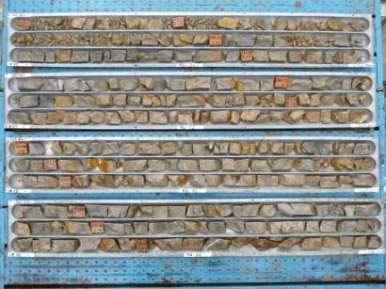
Primary
Where primary mineralization, including chalcopirite, bornite, molibdenite and pyrite
MQ52
 | Alt-K | Alt-Q-Ser | Alt-Prop
Total Sulf | 1 a 2% | 1 a 7% | 1 a 7%
Py/Cpy | 1:2/2:1 | 4:1 | 10:1
% Cu | 0.5 – 0.8% | 0.3 – 0.9% | 0.15%

Slide 18
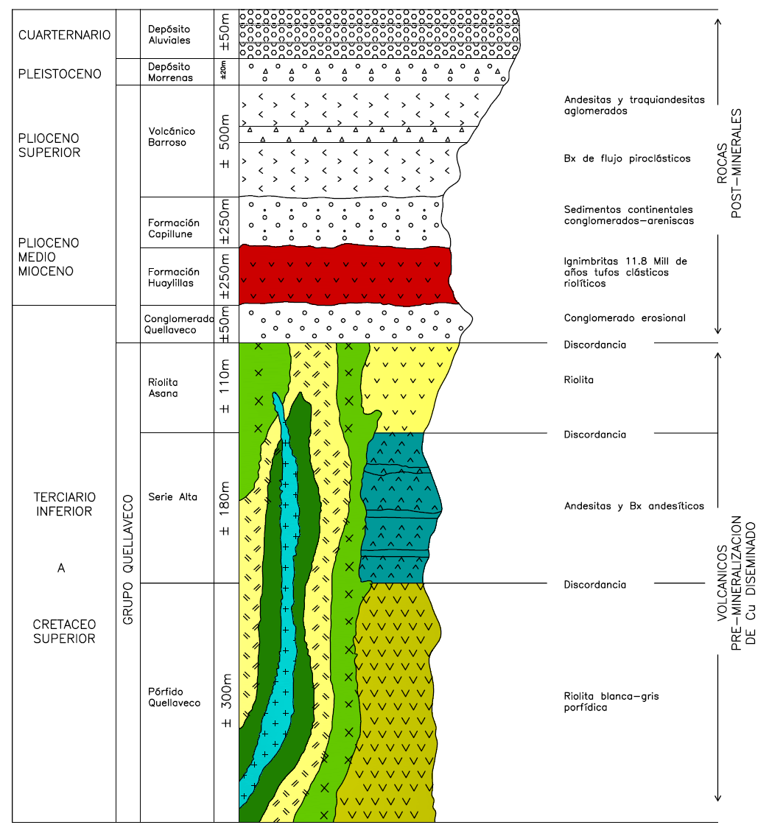
QUELLAVECO:
STRATIGRAPHIC COLUMN
Granodiorita equigranular gruesa 58 M de años
Pórfido qtz-Mz Temprano
Pórfido qtz-Mz-Intermedio
Pórfido qtz-Mz Tardío 54 M de años

Slide 19
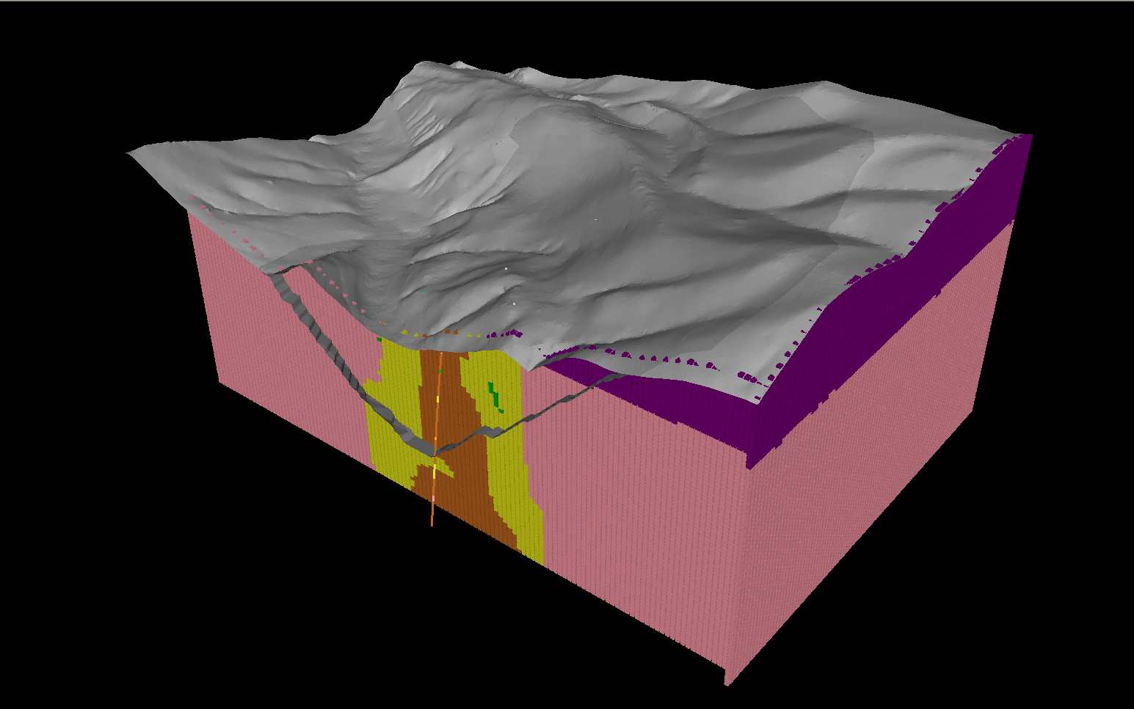
GEOLOGICAL MODEL
N
Level 3500
Rock Type
Early P.
Intermediate P.
Hidrotermal Breccia
Level 2790
Granodiorite
Ignimbrite
Level 3000
Level 2704
1 Km.

Slide 20
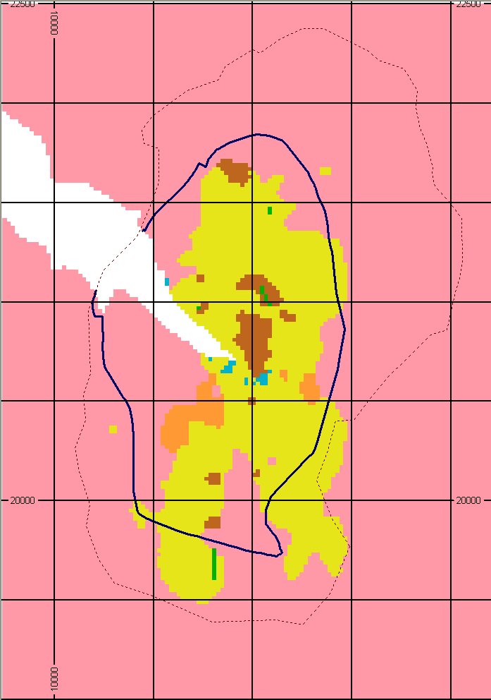
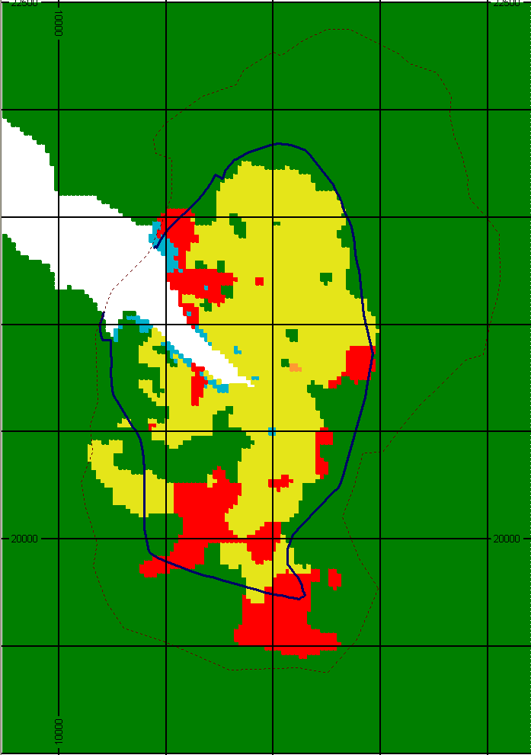
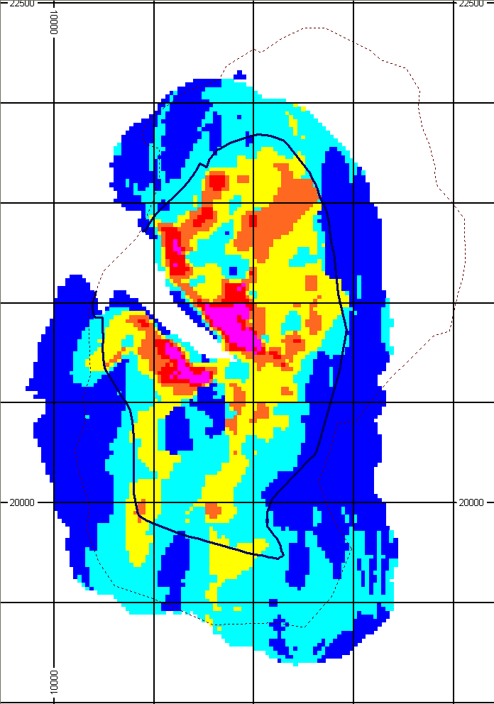
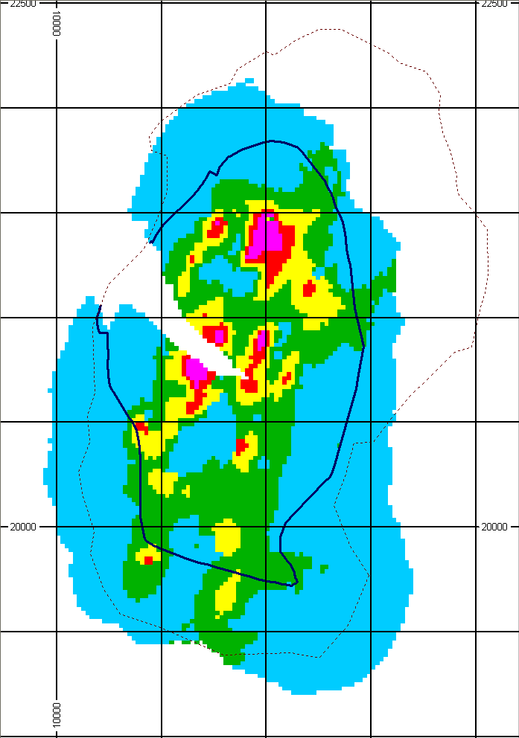
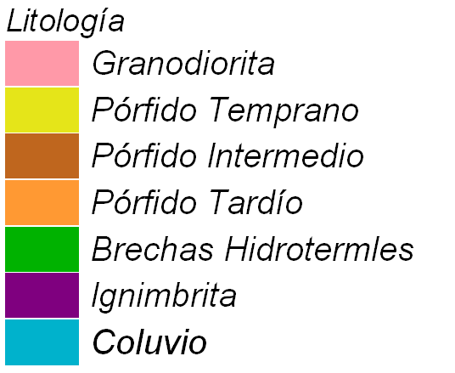
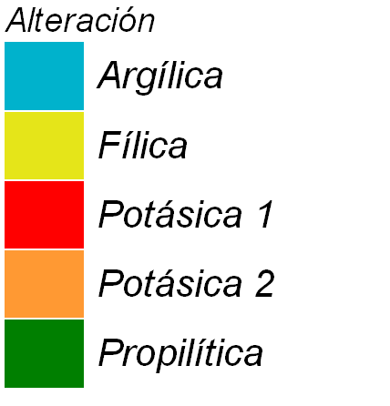
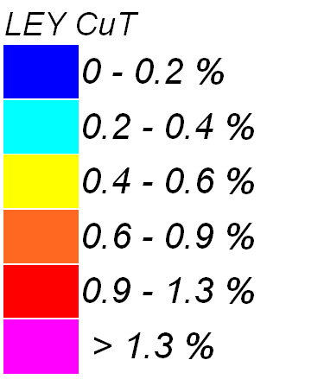
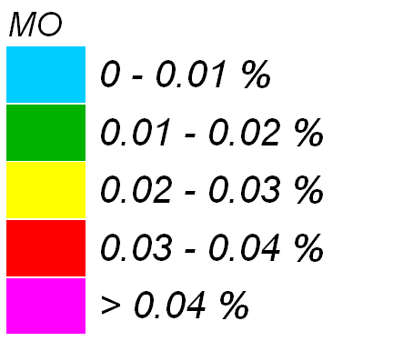
GEOLOGY
ALTERATION
CUT
MO
N
N
N
N
500m
500m
500m
500m

Slide 21
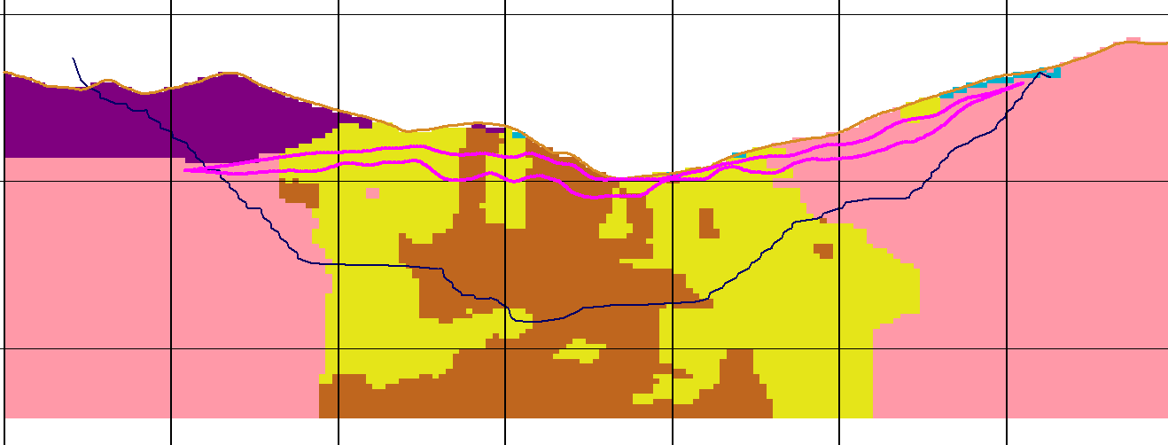
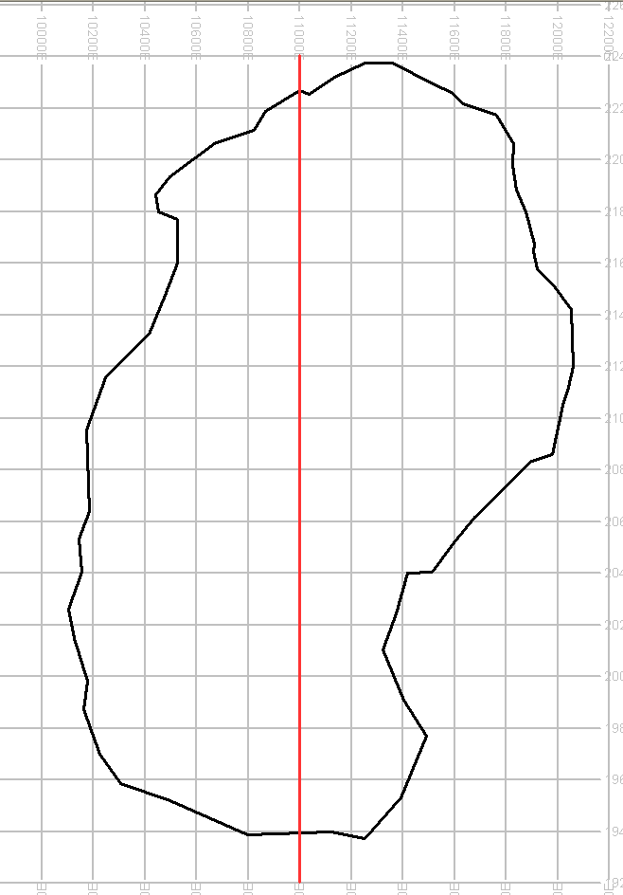
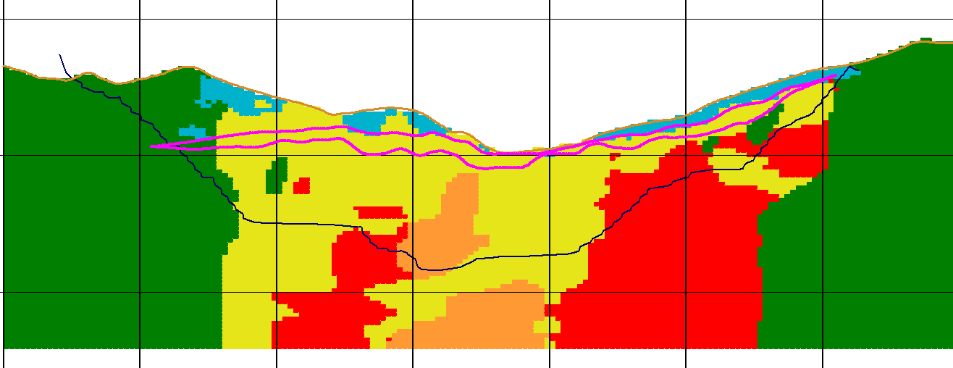
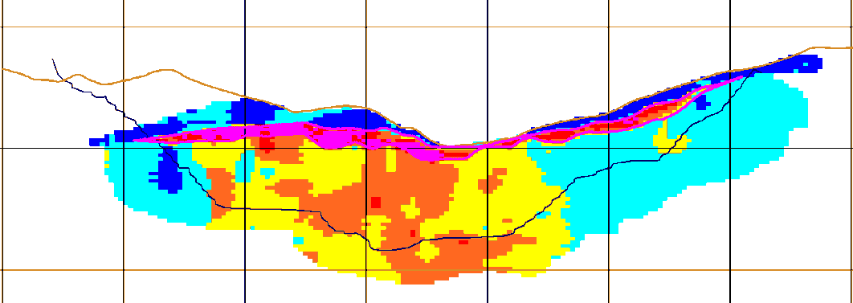
Section North - South
N
S
3500
3000
3500
3000
Mineralizaciòn
3500
3000
Secondary Enr.

Slide 22
EARLY PORPHYRY

Slide 23
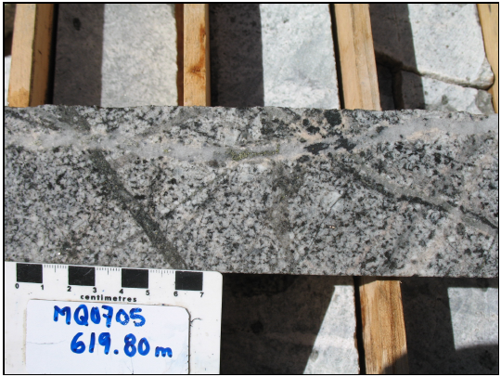
INTERMINERAL PORPHYRY

Slide 24
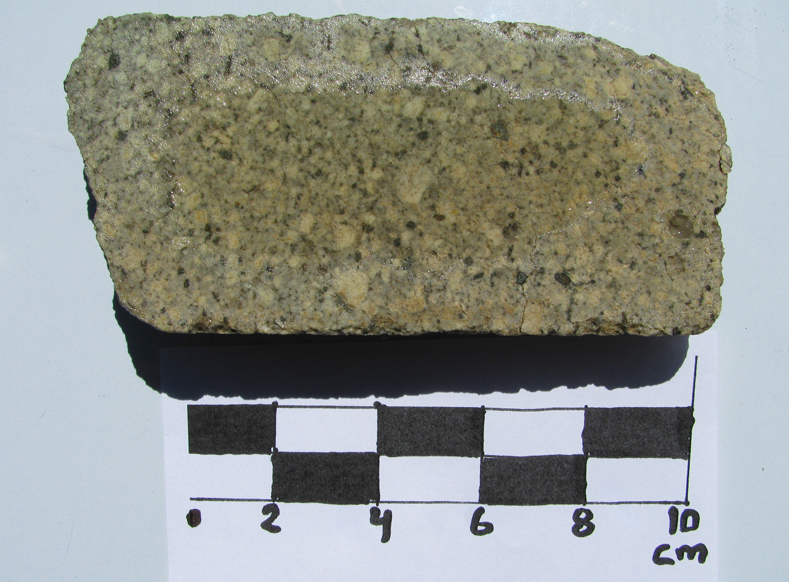
LATE PORPHYRY

Slide 25
MINERALIZED HYDROTHERMAL BRECCIA
LATE HYDROTHERMAL BRECCIA

Slide 26
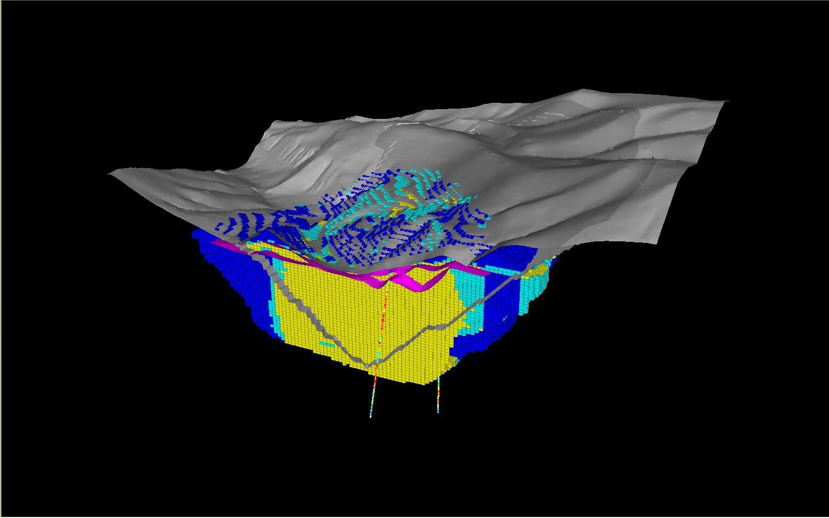
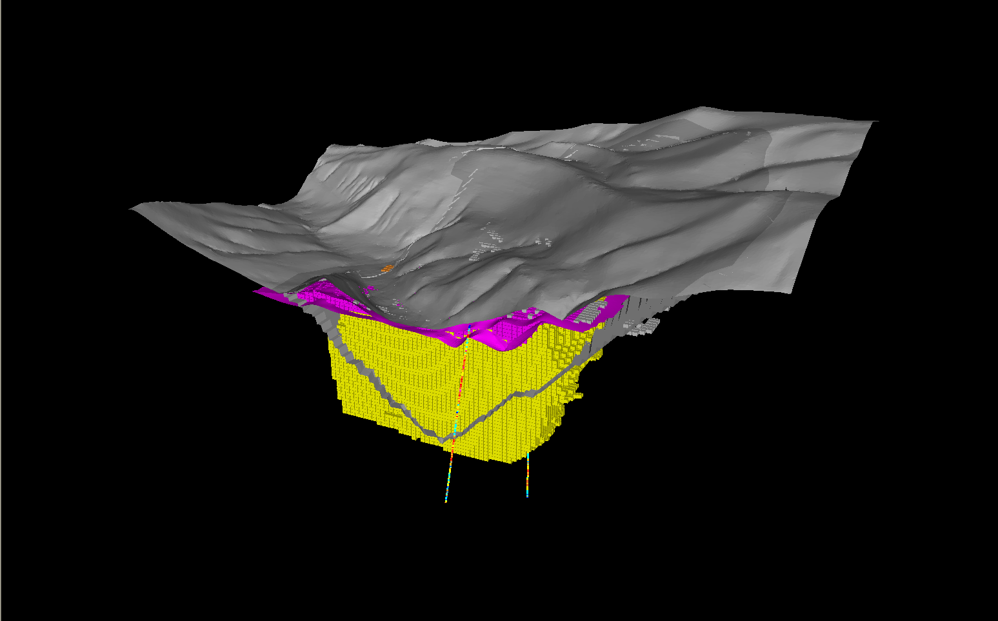
Nivel 3500
ZONA SECUNDARIA 15% del Recurso
0.93% CuT; 0.013% Mo
ZONA PRIMARIA 85% del Recurso
0.54% CuT; 0.021% Mo
Nivel 2940
>= 0.4% CuT

Slide 27
FINAL PIT
Vertical behavior of the resource (Cut-off 0.4%), Bench grade of mineral resource

Slide 28
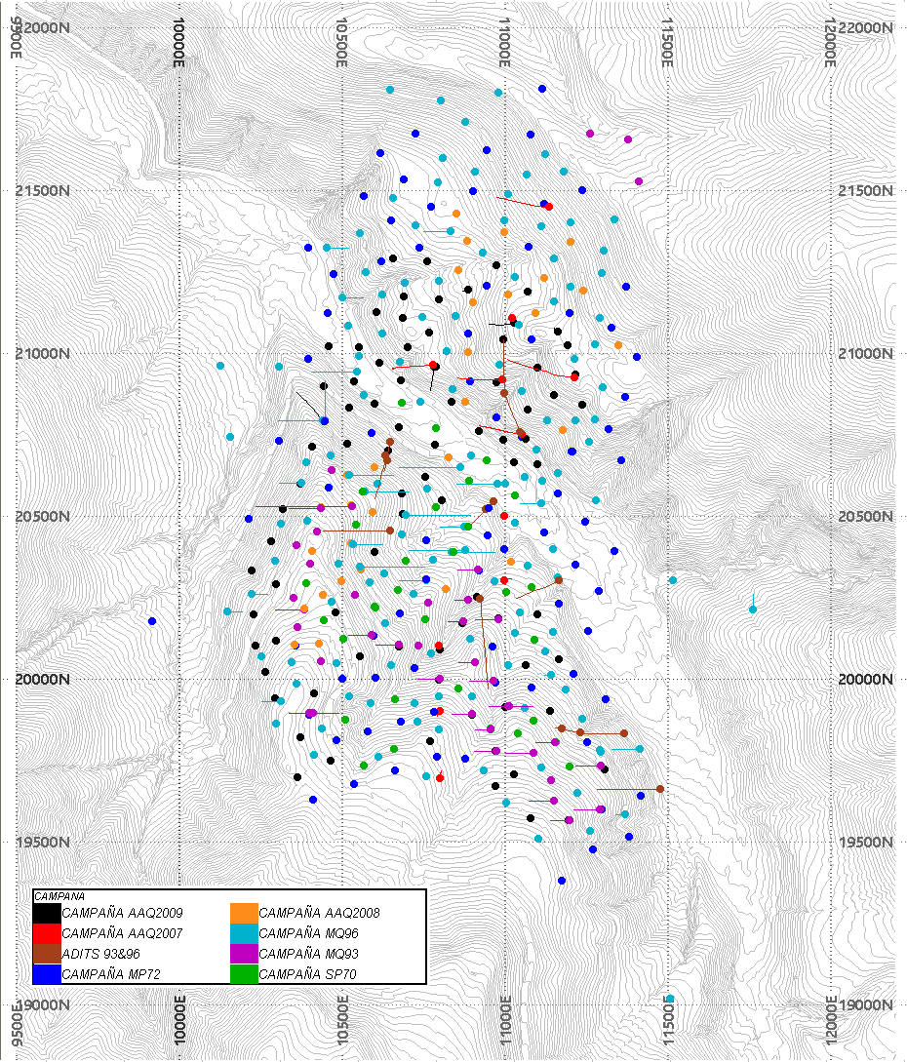
DRILLING CAMPAIGNS
COMPANY | CAMPAING | YEAR | #DRILL | TYPE | TOTAL LENGTH (m)
SPCC | SP70 | 1970 | 31 | DDH | 4,230
Minero Perú | MP72 | 1972 | 83 | DDH | 15,328
Minera Quellaveco | MQ93 | 1993 | 40 | DDH | 5,739
Minera Quellaveco | MQ96 | 1996 | 142 | DDH | 38,368
AAE | AAQ2007 | 2007 | 12 | DDH | 9,466
AAQSA | AAQ2008 | 2008 | 30 | RC | 5,569
AAQSA | AAQ2009 | 2009 | 86 | RC | 12,311
TOTAL |  |  | 424 |  | 91,011
Other Campaigns
COMPANY | CAMPAING | YEAR | #DRILL | TYPE | TOTAL LENGTH (m)
Northern Perú & S | NP47 | 1947 | 112 | Churn | 15,593
Minera Quellaveco | RP99 | 1999 | 7 | DDH | 1,970
Minera Quellaveco | Adit | 1993 y 1996 | 8 | Adit | 1,744

Slide 29
5.0
HIDROGEOLOGY

Slide 30
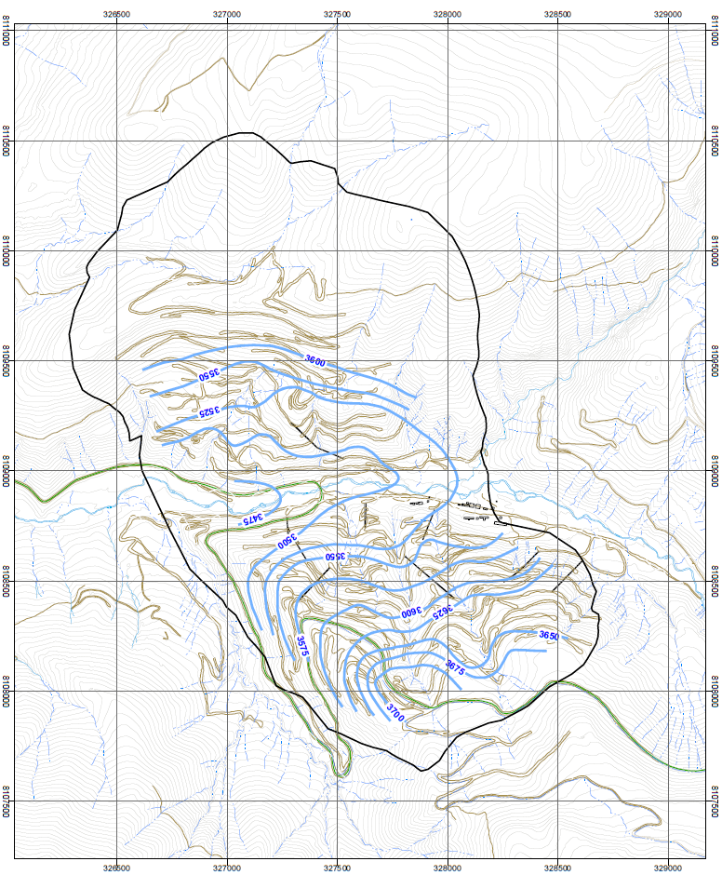
Hydrogeology
A
Falla Asana
The system does not control the behavior Asana Hydrogeological model
A’

Slide 31
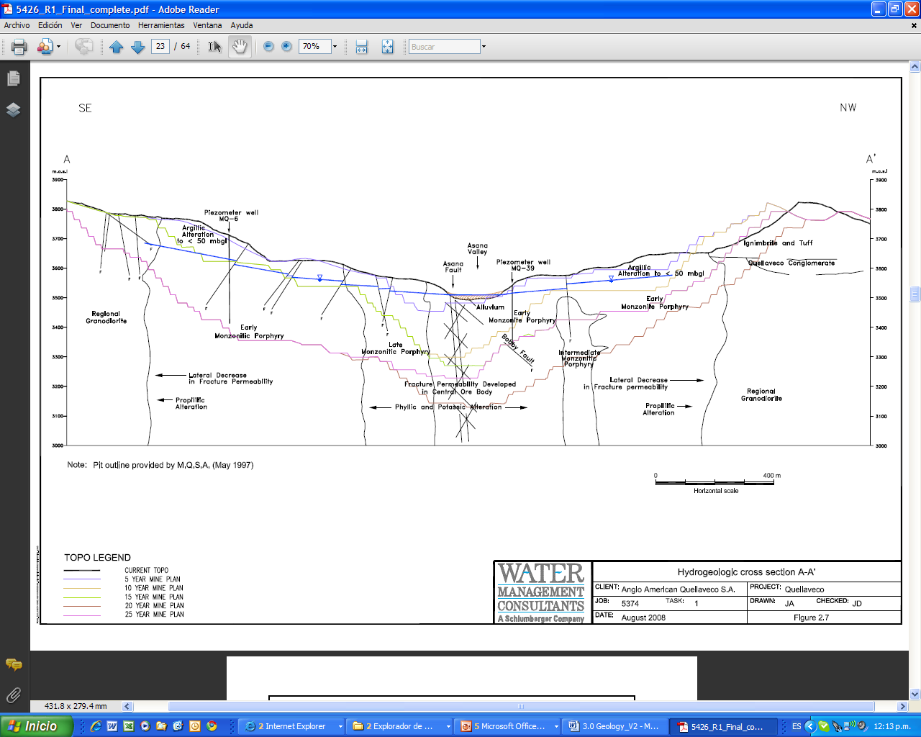
Secction A-A´
SE
NW
The water level varies from 150m in the upper at 15m in the valley.

Slide 32
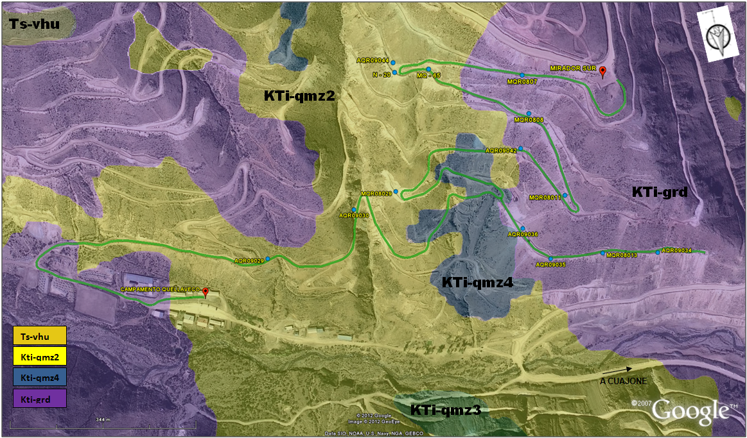
TYPICAL LEACH CAPPING - GEOLOGICAL TRACKING

Slide 33
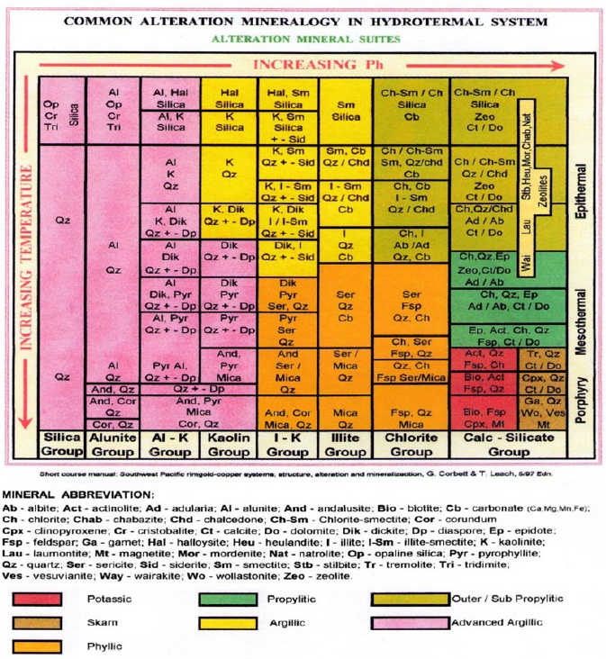

Slide 34
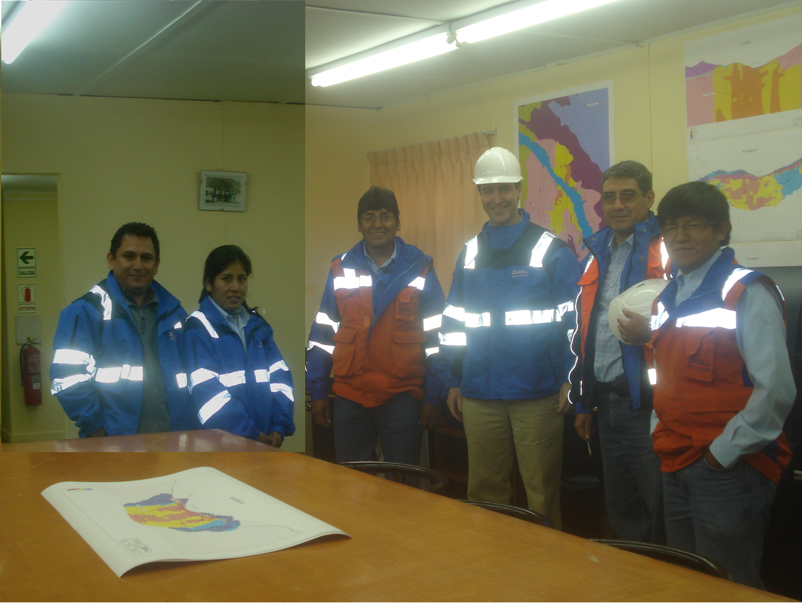
Thanks

